Slide 1
Hennepin County Geo:Code
Accessibility Jam
In partnership with Hennepin County Library, MN.IT Services, State of Minnesota Office of Accessibility and Open Twin Cities
January 31, 2015

Slide 2
AGENDA
Saturday, January 31
9:00 AM Welcome and coffee
9:15 AM Accessibility Jam Kickoff short presentations:
Bill Rodgers, Hennepin County Business Information Officer
Jay Wyant, State of Minnesota Chief Information Accessibility Officer
James Kauth, State of Minnesota Director of Innovation
Laura Andersen, Open Twin Cities Civic Design Lead
10:00 AM Idea Pitching and Team Formation
10:30 AM Five Whys and How Might We?
10:45 AM Stakeholder Mapping/Empathy/Personas
12:00 PM Lunch
1:00 PM Journey Mapping
3:00 PM Rapid Prototyping
4:00 PM Presentations
2

Slide 3
WHAT IS
SERVICE DESIGN?

Slide 4
If you asked ten people what service design is, you would end up with eleven different answers – at least.
- This is Service Design Thinking
4
Notes:
Not in Class Guide
This is an emerging discipline –emerging concurrently from multiple places.
There is not yet an agreed open formal definition of Service Design, but most you read will have the same spirit.

Slide 5
Service design helps to innovate or improve services to make them more useful, usable and desirable for clients; and efficient and effective for organizations. It is holistic, multi-disciplinary and integrative.
- Stefan Moritz, 2005
Notes:
This is a definition I like from a Swedish service designer.
This one is also from TiSDT, one of the 11+ definitions they refer to in the beginning of the book.
This stands out to me as explicitly stating the organizational efficiency gains brought about through a service design approach.

Slide 6
SOME HISTORY
Around the turn of the century, the government in the UK began hiring designers to help develop programs that provided services for vulnerable populations.
When they began publishing their results – services became more accessible to receive and more efficient to deliver – people paid attention.

Slide 7

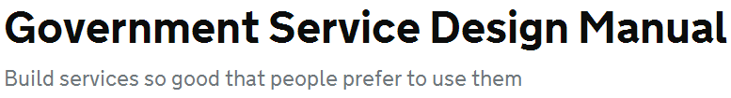
This stands out as a turning point in the cohesion of the Service Design discipline as a new approach to problem solving in increasingly complex multichannel service ecosystems.
Notes:
So, why did service design start developing when it did?

Slide 8
SERVICE DESIGN
Service design is a set of design principles and tools that were intentionally “packaged” to address complex services challenges.
Technology is human-created tools used to meet human needs and desires.
Technology is not independent from humanity.
Notes:
Hate to say created, developed. The tools of service design are pretty standard design tools. They are just applied differently in service design.

Slide 9
DESIGNING THE IDEAL EXPERIENCE
You can’t design an experience or culture, but you can design a context in which the experience or culture you wish to nurture can develop and thrive.
Service design is about intentionally designing an operational and infrastructural environment in which great experiences can occur.
Notes:
Not gonna happen

Slide 10
SERVICE DESIGN IS ITERATIVE AND TOOL BASED
High-fi prototyping & testing
Stakeholder mapping
Stakeholder interviews
Ethnographic research
Lo-fi prototyping & testing
Empathy maps
Personas
Let’s solve
a problem!
Monitor, test and iterate
Quantitative research
Customer interviews
Job shadowing
Mission Definition
Journey mapping
Service prototyping
Service blueprinting
Notes:
With interviews, go deeeeeeeeeeeeeep.
Use quantitative research to establish current state, but try not to use it to predict future state. So much changes.

Slide 11
SERVICE DESIGN IS ITERATIVE AND TOOL BASED
High-fi prototyping & testing
Stakeholder mapping
Stakeholder interviews
Ethnographic research
Lo-fi prototyping & testing
Empathy maps
Personas
Let’s solve
a problem!
Monitor, test and iterate
Quantitative research
Customer interviews
Job shadowing
Mission Definition
Journey mapping
Service prototyping
Service blueprinting
Notes:
You may not have to go all the way back here.

Slide 12
SERVICE DESIGN IS ITERATIVE AND TOOL BASED
High-fi prototyping & testing
Stakeholder mapping
Stakeholder interviews
Ethnographic research
Lo-fi prototyping & testing
Empathy maps
Personas
Let’s solve
a problem!
Monitor, test and iterate
Quantitative research
Customer interviews
Job shadowing
Mission Definition
Journey mapping
Service prototyping
Service blueprinting
Notes:
More likely you’ll only have to go back here.

Slide 13
SERVICE DESIGN IS ITERATIVE AND TOOL BASED
High-fi prototyping & testing
Stakeholder mapping
Stakeholder interviews
Ethnographic research
Lo-fi prototyping & testing
Let’s solve
a problem!
Empathy maps
Personas
Monitor, test and iterate
Quantitative research
Customer interviews
Job shadowing
Mission Definition
Journey mapping
Service prototyping
Service blueprinting
www.servicedesigntools.org
Notes:
I’ll provide a list of resources at the end of class on Wednesday.

Slide 14
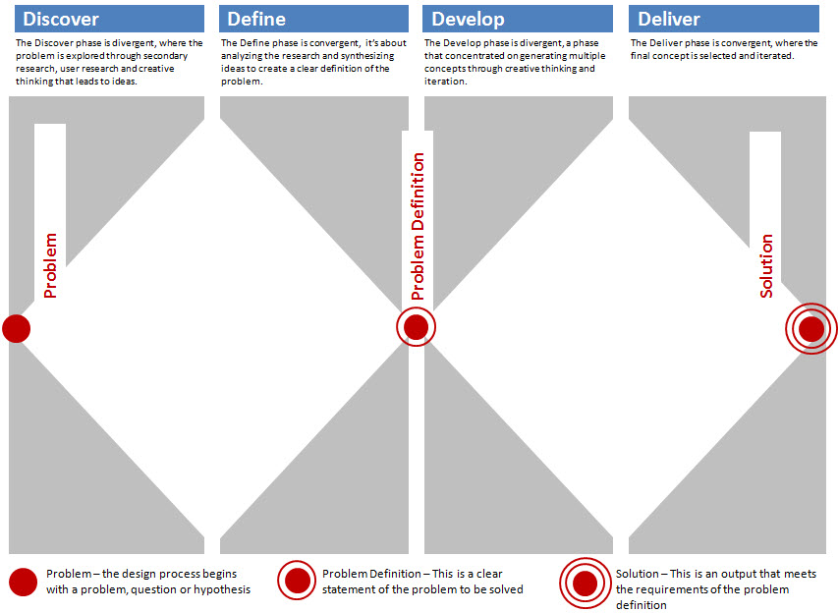
Notes:
The double diamond – divergent and convergent phases of service design.

Slide 15
High-fi prototyping & testing
Stakeholder interviews
Lo-fi prototyping & testing
Stakeholder mapping
Empathy maps
Job shadowing
Personas
Monitor, test and iterate
Quant research
Ethnographic research
Mission Definition
Journey mapping
Service prototyping
Customer interviews
Service blueprinting

Slide 16
SERVICE DESIGN AND CULTURE
Service design is inclusive and collaborative. People who may not normally interact have a chance to collaborate with those whose work they impact and are impacted by.
It’s anti-hierarchical. The very nature of the approach allows for voices that aren’t often heard to be heard.
Notes:
Service design

Slide 17
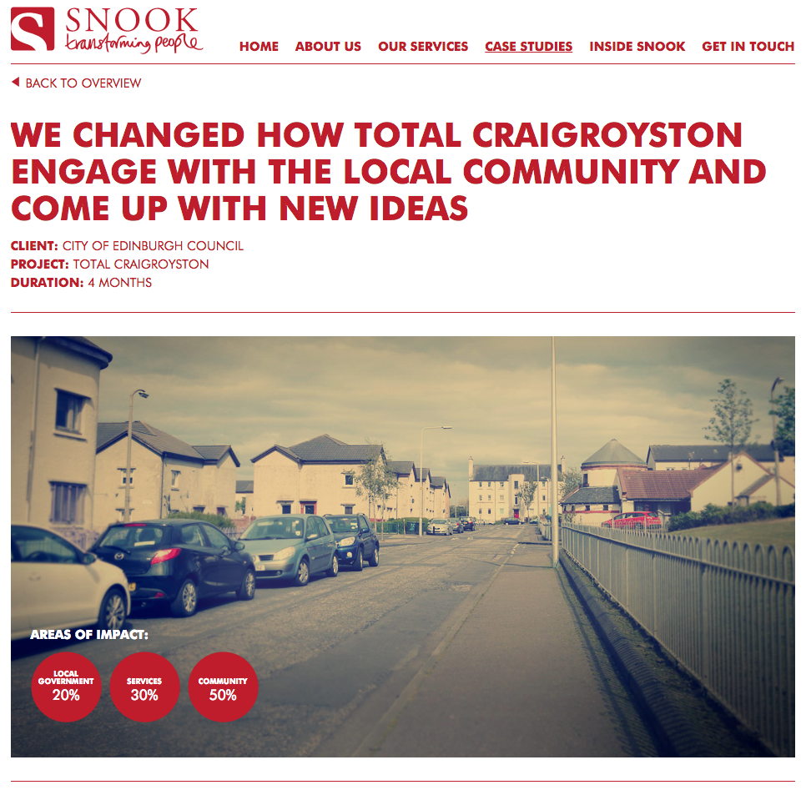
http://wearesnook.com/snook/?case=craigroyston-total-place

Slide 18
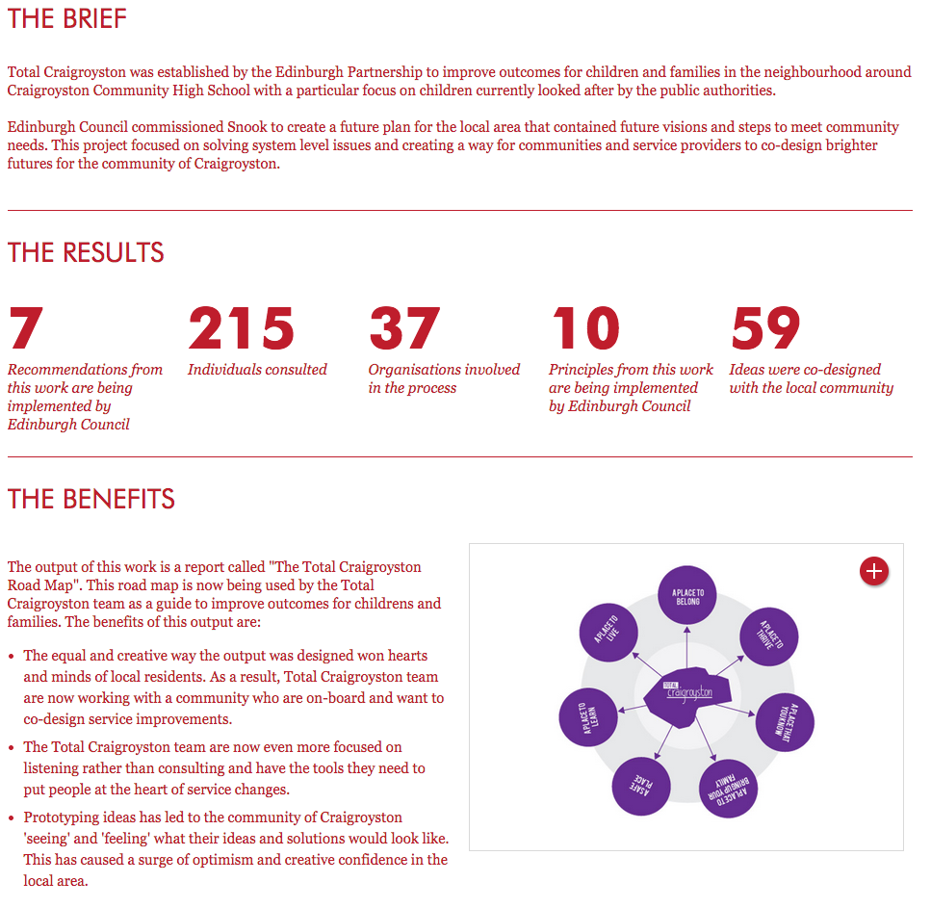
http://wearesnook.com/snook/?case=craigroyston-total-place

Slide 19
STAKEHOLDER
MAPPING

Slide 20
STAKEHOLDER /ˈstākˌhōldər/ noun
A person with an interest or concern in something.

Slide 21
Stakeholder maps are a critical tool of service design that documents all parties involved in or impacted by a project or change.

Slide 22

PROJECT X STAKEHOLDER MAP – Constituent at center
Constituent
Icons by TiSDT.

Slide 23







PROJECT X STAKEHOLDER MAP – Internal Stakeholders
Event Manager
Development
Grant Writers
Web Team
Constituent
Admin Staff
Program Managers
Executive Director
Icons by TiSDT.

Slide 24




PROJECT X STAKEHOLDER MAP – External Stakeholders
Board Members
Volunteers
Event Manager
Development
Grant Writers
Individual funders
Web Team
Constituent
Admin Staff
Program Managers
Executive Director
Grantors
Community Partners
Icons by TiSDT.

Slide 25
USING STAKEHOLDER MAPS
Stakeholder maps work as a simple visualization to better understand and communicate the groups impacted or involved in a project.
They prompt awareness of missing stakeholders and can convey how all the different parts work together to support a process.
Stakeholder maps will be a work in progress
Notes:
In a service design project, the stakeholder map can be used to identify internal and external interview targets, and as a tool to gain insight into how different people and group currently do and do not work together.

Slide 26
PROJECT X STAKEHOLDER MAP – External Stakeholders
Board Members
Volunteers
Event Manager
Development
Grant Writers
Individual funders
Web Team
Constituent
Admin Staff
Program Managers
Executive Director
Grantors
Community Partners
Icons by TiSDT.

Slide 27
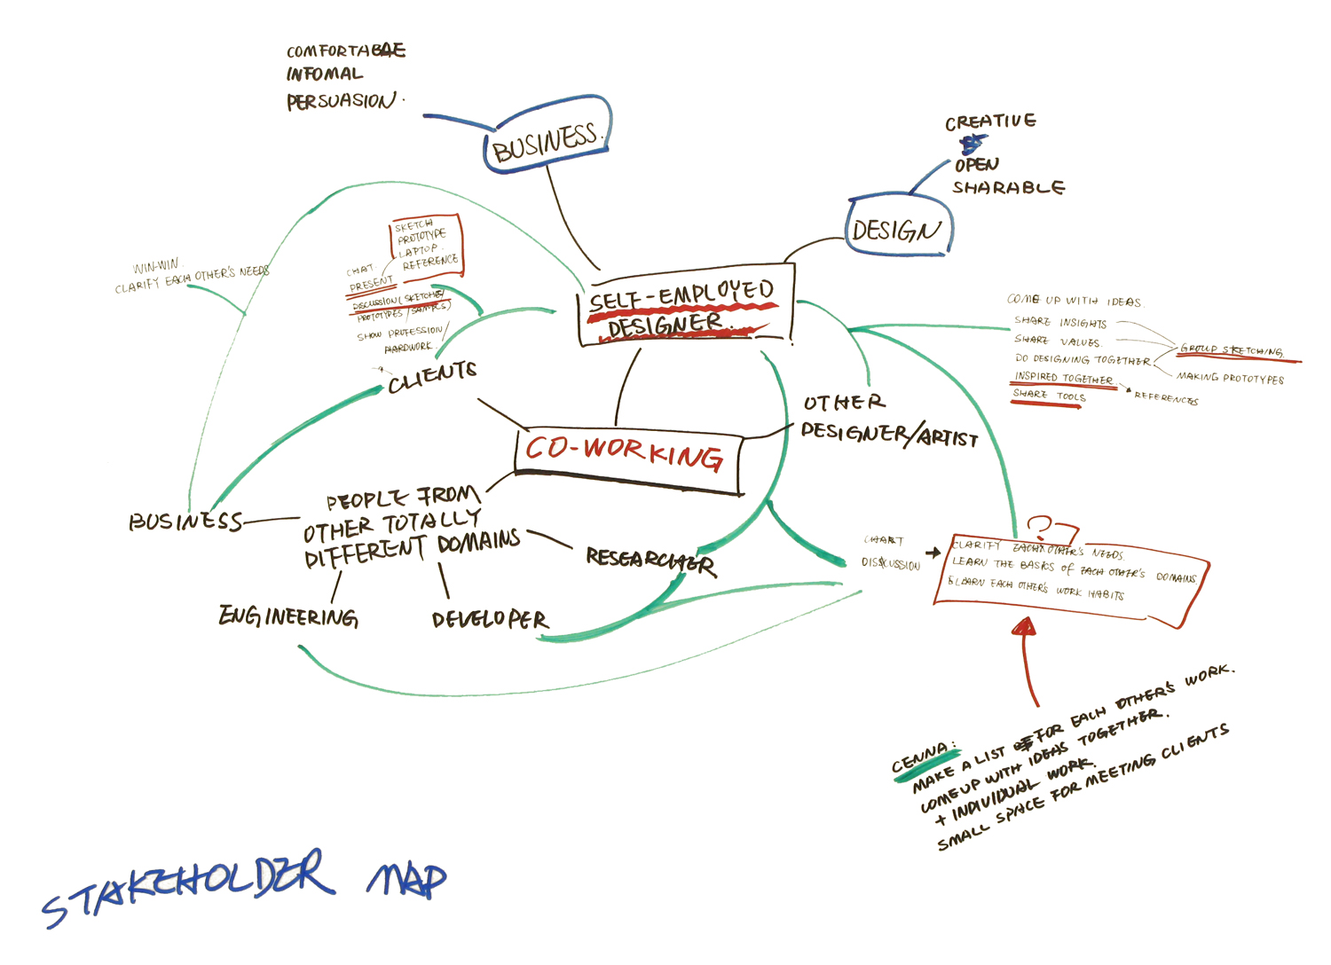
Image via http://haoyusmasterproject.files.wordpress.com//
Notes:
Haoyu Zheng’s Masters project on the impact of furniture on coworking spaces

Slide 28
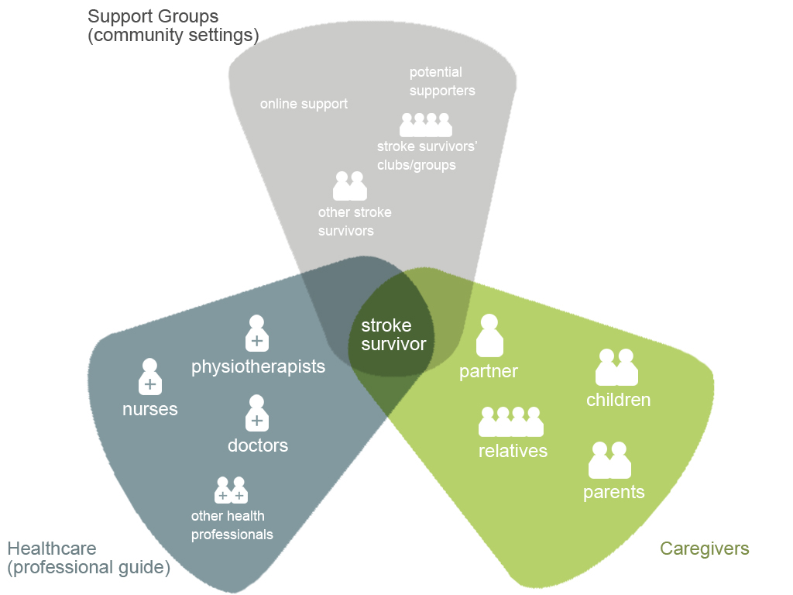
Image via http://liwenyisd.wordpress.com
Notes:
Wenyi Li’s Masters project on after-stroke care

Slide 29
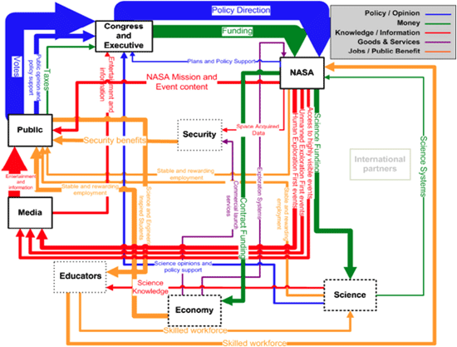
Image via MIT

Slide 30
RESEARCH

Slide 31
Service design relies on qualitative research
One must understand context to truly understand a service experience

Slide 32
Observe
Observe your constituents in their service environment. When it’s not feasible to observe them, as them to document their experience through pictures, journals and mobile ethnography apps.
Engage
Don’t just ask about an incident or an interaction, talk about the entirety of a customers’ experience, from pre-consideration through reconsideration.

Slide 33
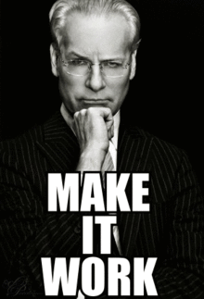
Seek out extreme users
Looking outside the median can lead to brilliant insights from users who are actively using your product or service.
Look for problems and workarounds
People will, in the immortal words of Tim Gunn, Make it Work.
How are they using and adapting your product or service? If this is what your service is supposed to do, why are they working so hard? What can you learn from this?

Slide 34
Cool story, bro
This all takes time. Know what we don’t have a lot of today? Time.
But that’s OK!

Slide 35
PERSONA
DEVELOPMENT

Slide 36
We use personas in service design so that we’re able to tell the story of an experience from a developed perspective.
Personas are created through research, and are usually an amalgamation of multiple real service users and providers.
Notes:
We use demographic information as a springboard, but really try to round out the personas as individuals.

Slide 37

Per demographic research
Male
Born in 1948
Raised in England
Married
Have at least 2 children
Like dogs
Successful and wealthy
Love the Alps
Via TiSDT.

Slide 38

Per demographic research
Male
Born in 1948
Raised in England
Married
Have at least 2 children
Like dogs
Successful and wealthy
Love the Alps
Via TiSDT.

Slide 39
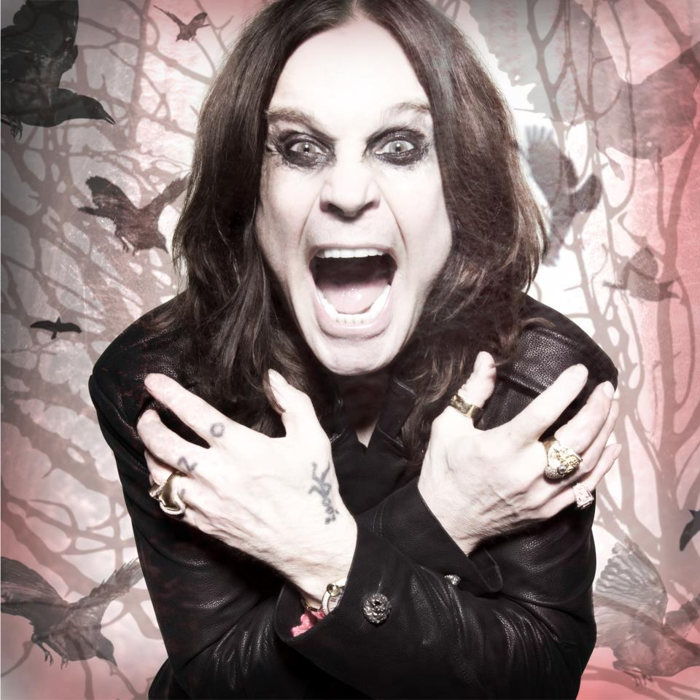
Per demographic research
Male
Born in 1948
Raised in England
Married
Have at least 2 children
Like dogs
Successful and wealthy
Love the Alps
Via TiSDT.

Slide 40
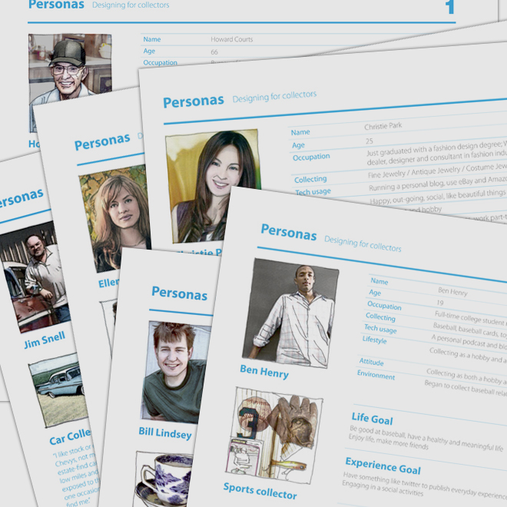
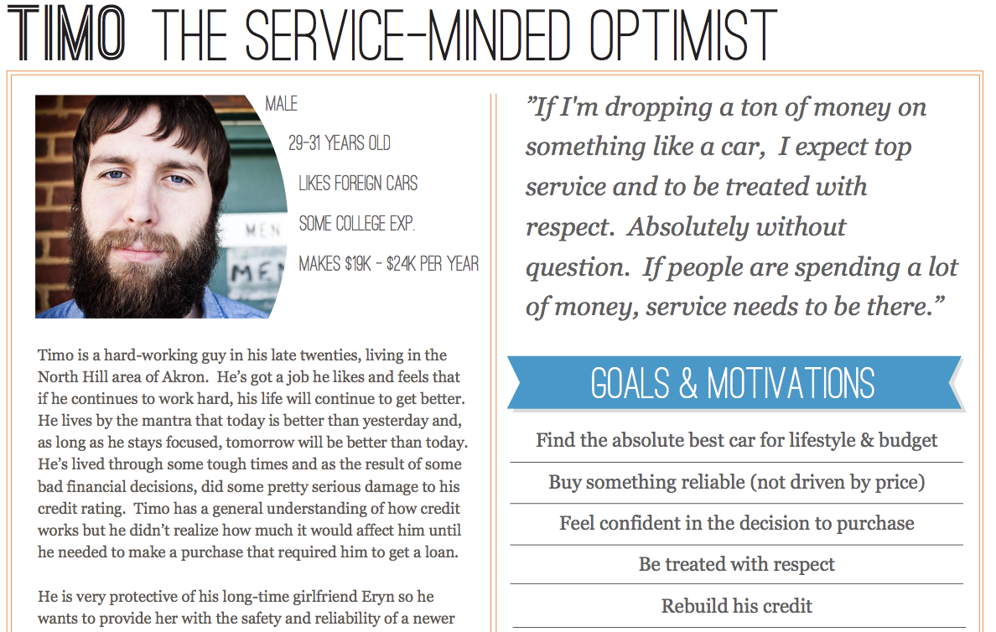
Create your persona
Personas should include information about the subject that goes beyond their relationship or interaction with your organization
Create a back story for your persona. Give them character and personality.
Detail their fears and motivations

Slide 41
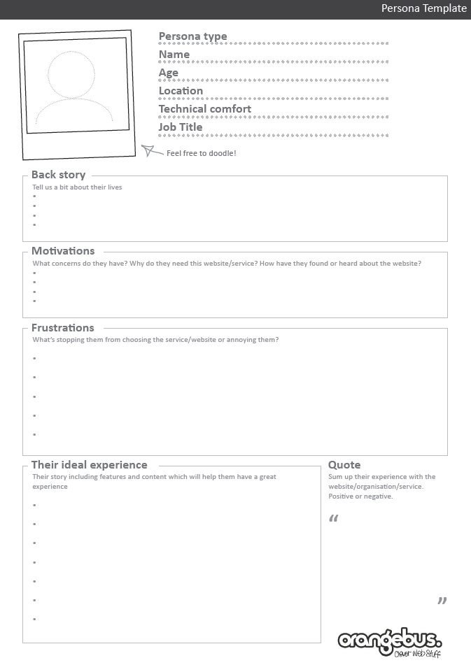

Slide 42
EMPATHY MAPPING

Slide 43
Empathy, noun \ˈem-pə-thē\:
the feeling that you understand and share another person's experiences and emotions: the ability to share someone else's feelings

Slide 44
Empathy is critical to successful service design
To design effective products and services you must care to understand whether and how it solves your constituents’ problems.
Service design helps you develop your empathy
Almost without effort, by following services design practices and participating in service design engagements, you will find yourself being more objective and looking for context in situations that don’t seem to be going well.

Slide 45
Empathy mapping is a tool used to better understand the environment and circumstances of those who are impacted by the problem we’re trying to solve.

Slide 46
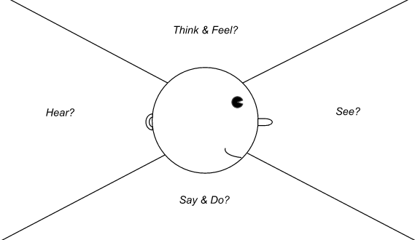

Slide 47
Developing an empathy map for primary stakeholders helps you get into the correct mindset for activities like Journey Mapping.
We gain understanding and insight into how the problem impacts job performance and user experience, and the unintended/unexpected impacts we can’t always identify through traditional analysis processes.

Slide 48
JOURNEY MAPPING

Slide 49
Journey mapping enables the discovery of challenges and inconsistencies that our constituents may encounter that may not be obvious or visible
It make an intangible service or experience tangible, and therefore easier to evaluate and address, and allows for evaluation of specific touch points (website, email, mail, TAGS, etc.) in the context of the whole experience

Slide 50
Journey mapping is an exercise where one organizes and maps the touchpoints their customers or employee interact with, the systems and tools that support these touchpoints, and the emotional impact of those interactions.

Slide 51
Journey mapping doesn’t entail just the users interaction with product or service. We should consider their journey from pre-consideration through re-consideration.

Slide 52
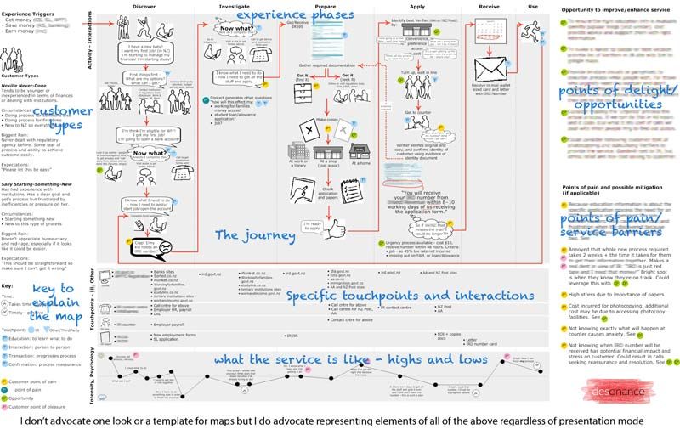
Notes:
Tell story of finding this journey map.

Slide 53
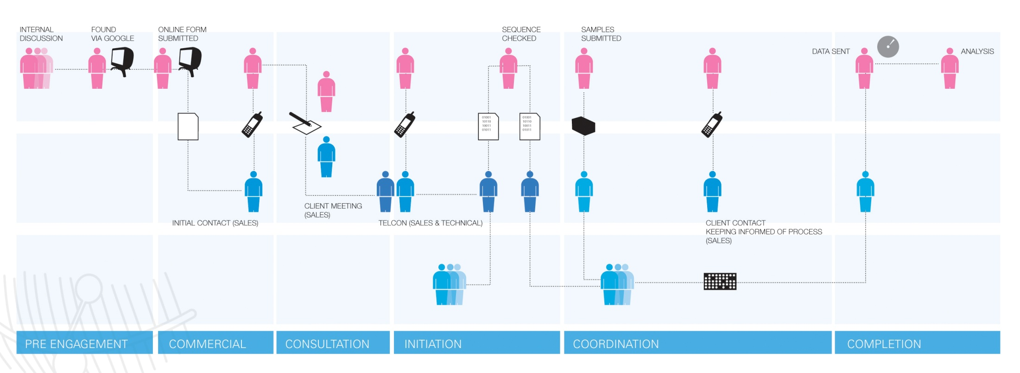

Slide 54
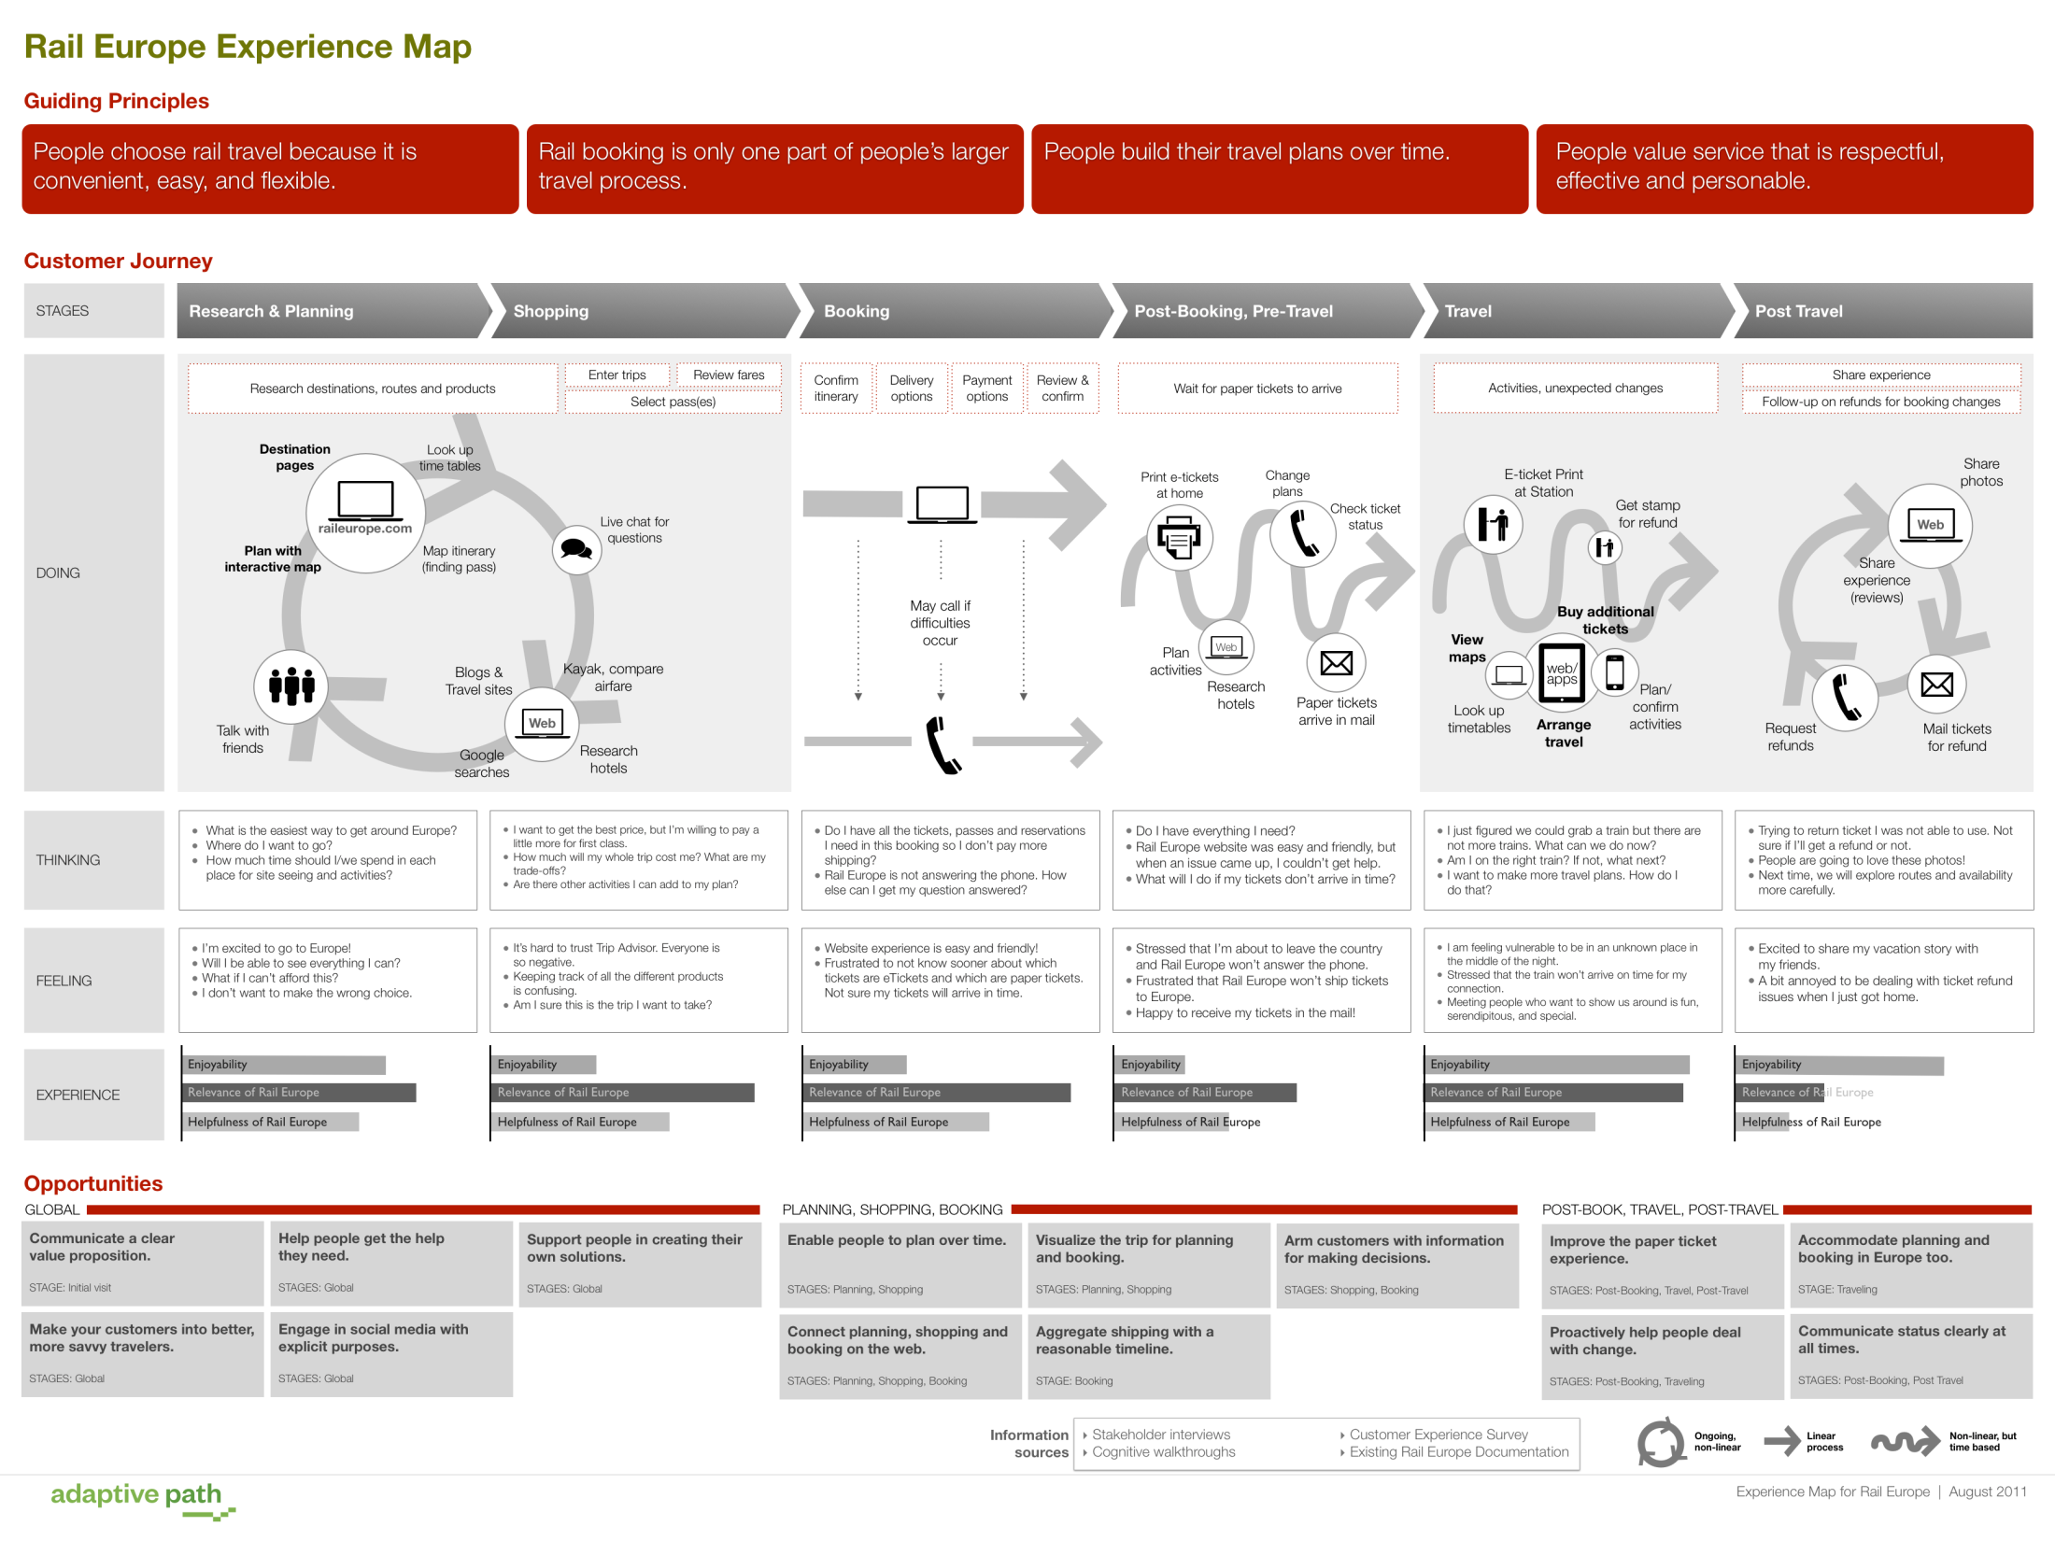
Image via Adaptive Path.

Slide 55
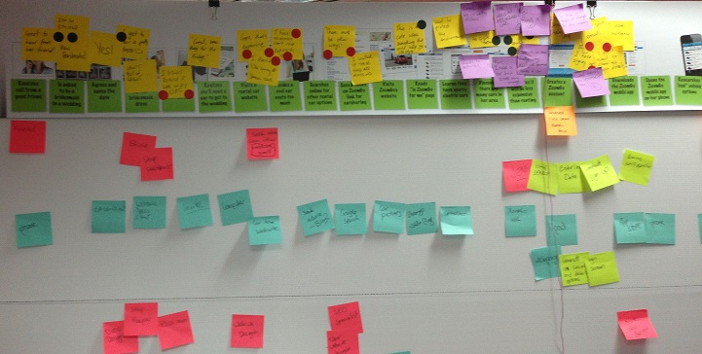
Our Maps are going to look more like this:
Image via Hothouse Interactive.

Slide 56
Once completed, we’ll have a better, broader understanding of the experience being delivered today, the problem’s role in that experience, and how changes could impact other processes and touch points.
We’ll have a tangible record of the experience to facilitate further conversations about service improvements.
We can better identify and prioritize experience improvements.

Slide 57
TOUCHPOINTS
Any point of contact between a service user and a service provider

Slide 58






TOUCHPOINT IDENTIFICATION
What are all the points of engagement throughout the experience?
These will be things like website, calls, emails, tags, receipts, in-store materials, conversations with Design Associates, etc.

Slide 59
TOUCHPOINT SEQUENCING
Once you’ve identified all the touchpoints, you’ll organize them sequentially.
It’s very likely you’ll think of more touchpoints through this process – go ahead and add them in.
Icons by TiSDT.

Slide 60








PEOPLE, TECHNOLOGY AND PROCESS
Who are the stakeholders, internal and external, in this service delivery? What systems and technology are they using? What processes are they following and who established them?
Icons from This is Service Design Thinking

Slide 61


EXPERIENTIAL EXPANSION
What is the customer feeling at different points in the process?
What are internal staff feeling and experiencing throughout the process?
Icons from This is Service Design Thinking

Slide 62
PROTOTYPING

Slide 63
A prototype is an Interactive Model of a product, service or system
-Fred Beecher, The Nerdery

Slide 64
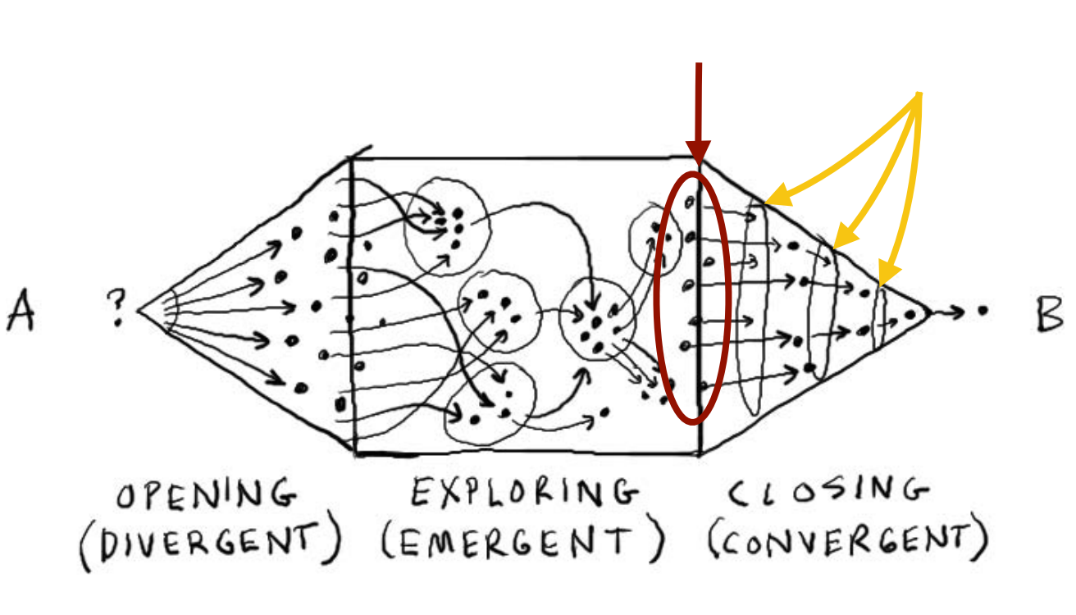
Prototypes happen here
Personas, research and Journey Mapping
PROTOTYPING
Team Formation
Testing and Iterating
Theme Reveal
Brainstorming
Diagram @2010 Dave Gray

Slide 65
Prototyping makes your idea tangible
People don’t know how they’ll respond to something merely by hearing about it.
They touch it. Play with it. Experience it.

Slide 66
Prototyping is cheap and easy
Got a pencil and paper? Boom! You can prototype
People are creative and imaginative. If you put something in their hands that represents something else, they’ll treat it as the something else.

Slide 67
What’s a prototype?
A sketch
An enactment of a service experience (improv is a great skill for service designers)
A cardboard representation of an object
A semi-functional website
By making your idea tangible, you’ve made a prototype

Slide 68
Why do we prototype
To get feedback – people respond to tangibility. They’re better able to articulate their response to an object than an idea.
You’re developing something for others to use. The less involvement you have from others, the less likely you are to be able to let things go.
You have to let things go. Early rapid prototyping helps provide feedback that you can use before you’ve invested too much time and effort for it to comfortably fail.

Slide 69
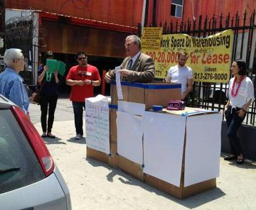
What’s a prototype
Mobile City Hall
2013 LA GovJam

Slide 70
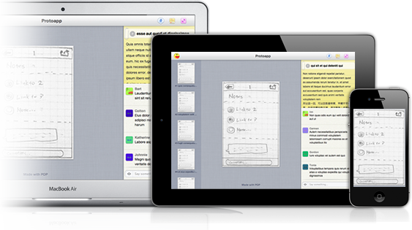
What’s a prototype
POP: Prototyping on Paper, The Internet

Slide 71
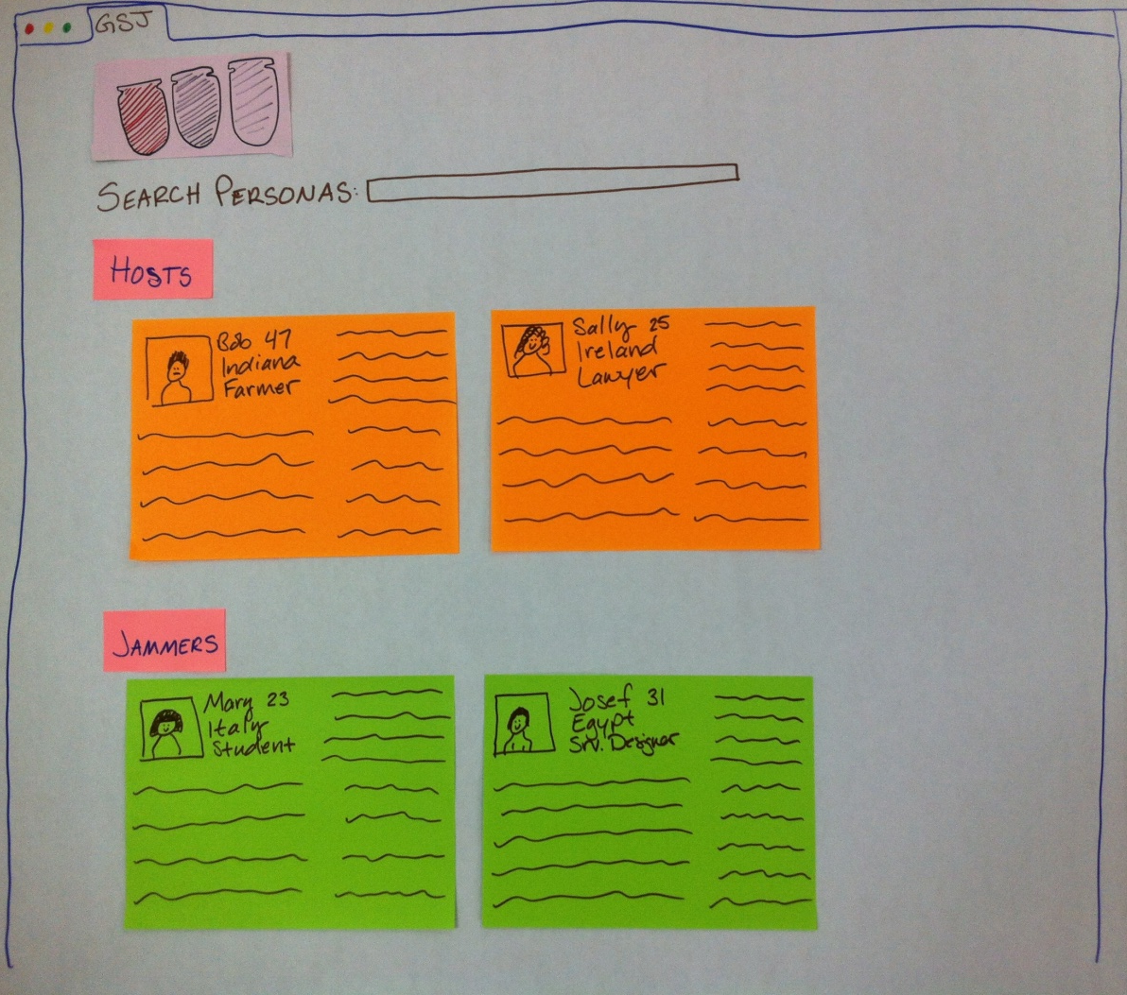
What’s a Prototype?
Jammer Persona Repository
GSJamJam, Sao Paulo

Slide 72
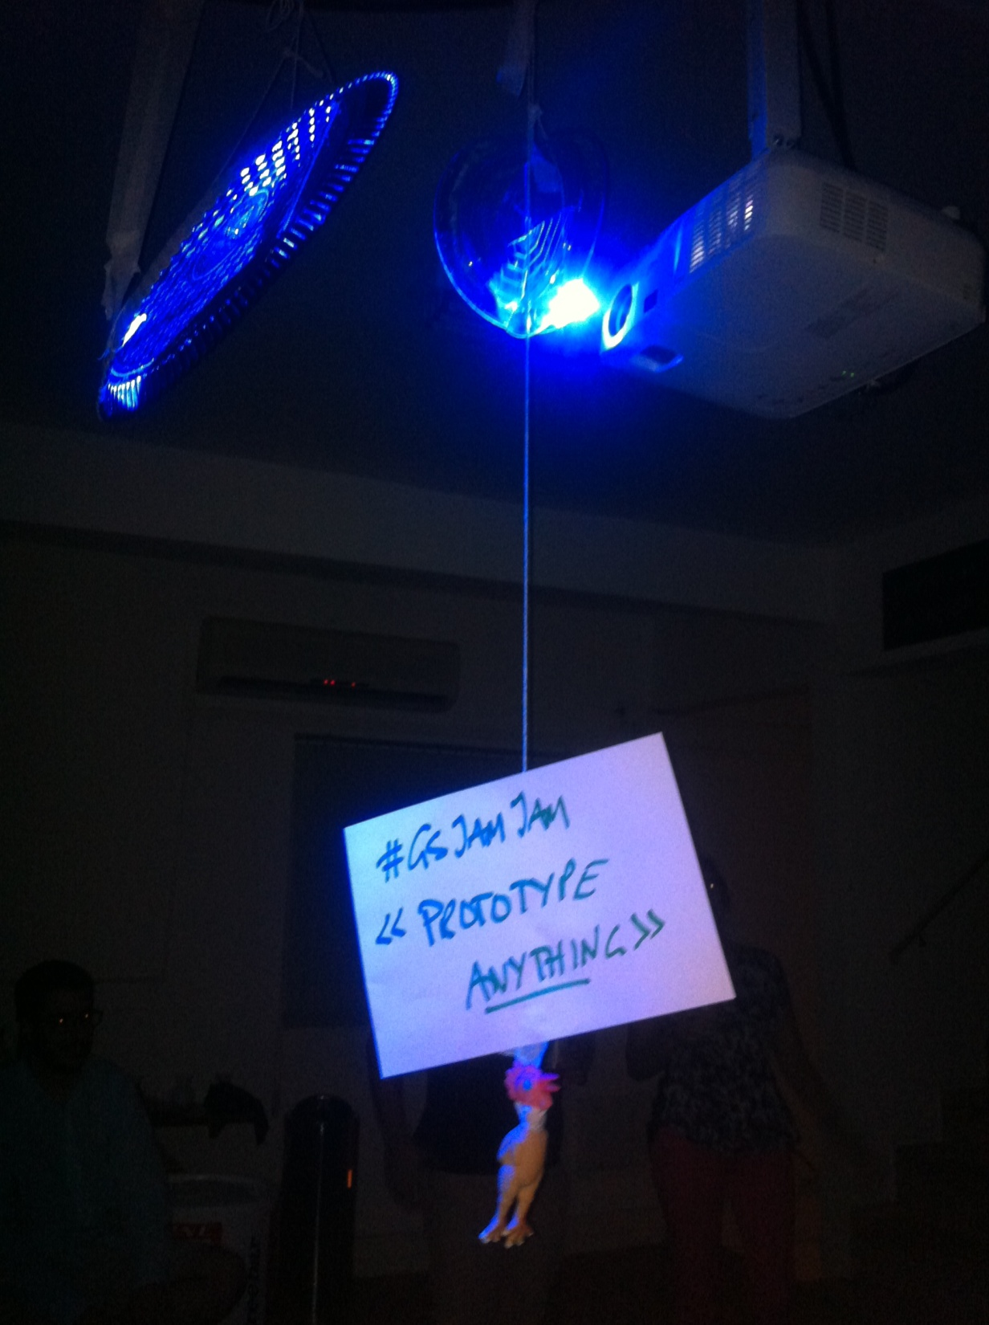
What’s a prototype
Disco Ball
GSJamJam, Sao Paulo

